Slide 1
Introduction to Big Data

Slide 2

What Launched Big Data Era???
Big Data – Growing Torrent

Slide 3
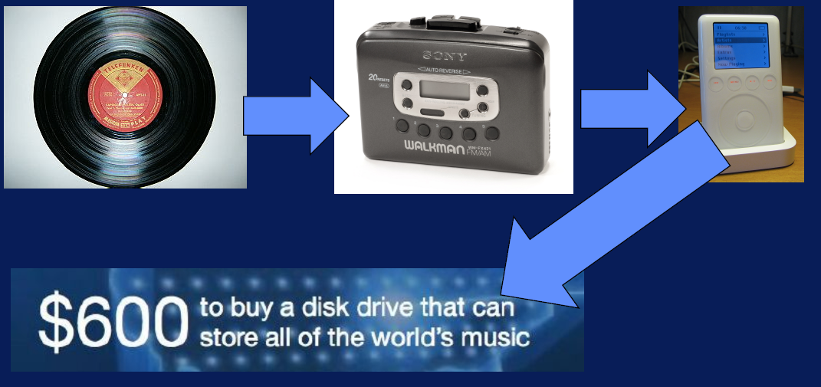
What Launched Big Data Era???

Slide 4

What Launched Big Data Era???
5 billion Mobile Phones

Slide 5

What Launched Big Data Era???

Slide 6

What Launched Big Data Era???
40% growth in global IT data

Slide 7

What Launched Big Data Era???
Cloud Computing
-
Computing- Anytime, Anywhere

Slide 8


Slide 9
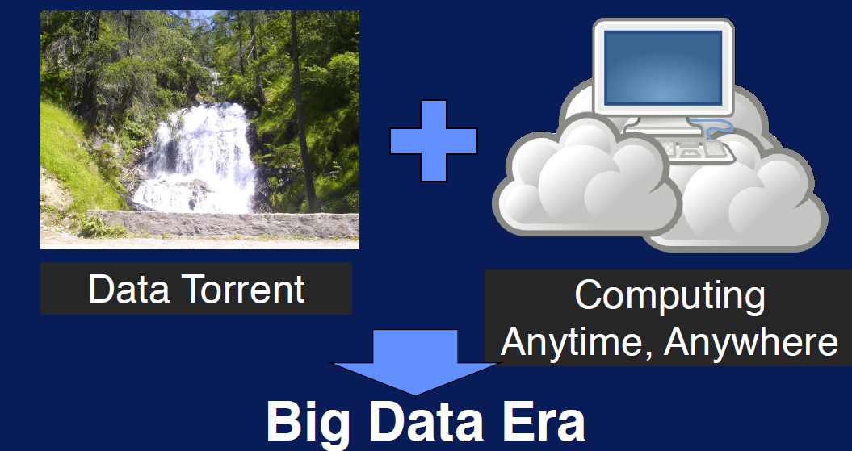

Slide 10
20 Facts about Big Data (1)
Every Two days we create as much information as we did from the beginning of time until 2003

Slide 11
20 Facts about Big Data (2)
Over 90% of data in the world is created in past two years

Slide 12
20 Facts about Big Data(3)
It is expected that by 2020 amount of digital information in existence will have grown from 3.2 zettabytes today to 40 zettabytes

Slide 13
20Facts about Big Data(4)
The total amount of data being captured and stored by industry doubles every 1.2 years

Slide 14
20 Facts about Big Data(5)
Every minute we send 204 million Emails,Generate 1.8 million Facebook likes,
Send 278 thousand tweets, upload 200,000 photos on fb

Slide 15
20 Facts about Big Data(6)
Google alone processes an average over40 thousand search queries per second, make it in over 3.5 billion in single day

Slide 16
20 Facts about Big Data(7)
Around 100 hours of video are uploaded on you tube every minute and it would be take around 15 years to watch every video uploaded by users in one day

Slide 17
20 Facts about Big Data(8)
If you burned all of the data created in just one day onto DVDs , you could stack them on top of each other and reach the moon twice.

Slide 18
20 Facts about Big Data(9)
570 new websites come to existence in every minute of every day

Slide 19
20 Facts about Big Data(10)
1.9 million IT jobs will be created in US by 2015 to carry out Big Data projects. Each of those will be supported by 3 new jobs created outside IT- Meaning a total 6 million new jobs thanks to Big Data

Slide 20
20 Facts about Big Data(11)
Today’s data center occupy an area of land equal in size to almost 6000 football fields

Slide 21
20 Facts about Big Data(12)
Between them companies monitoring tweeter to measure “Sentimet” analyze 12 terabytes of tweets everyday

Slide 22
20 Facts about Big Data(13)
Mobile Data increased by 81% to 1.5 Exabytes(1.5 billion GigaBytes) per month between 2012 and 2014. Video accounts for 53% of total.

Slide 23
20 Facts about Big Data(14)
According to Allied Market Research Firm, Hadoop market is expected to soar from $2 billion in 2013 to $50 billion in 2020.

Slide 24
20 Facts about Big Data(15)
Number of bits stored in digital universe thought to have exceeded the no of stars in the physical universe

Slide 25
20 Facts about Big Data(16)
The boom of IoT will mean that the devices connected to internet will increase from 13 billion to 50 billion by 2020

Slide 26
20 Facts about Big Data(17)
Big Data will be used to predict crime before it happens-”Predictive Policing”

Slide 27
20 Facts about Big Data(18)
By better integrating Big Data to healthcare industry could save $300 billion a year- that is the equivalent of reducing the health care cost of every man, woman and a child by $1000 a year

Slide 28
20 Facts about Big Data(19)
Retailers can increase their profit margin by 60%

Slide 29
20 Facts about Big Data(20)
The Big data Industry is expected to grow from US $10.2 billion in 2013 to about US $54.3 billion by 2020

Slide 30
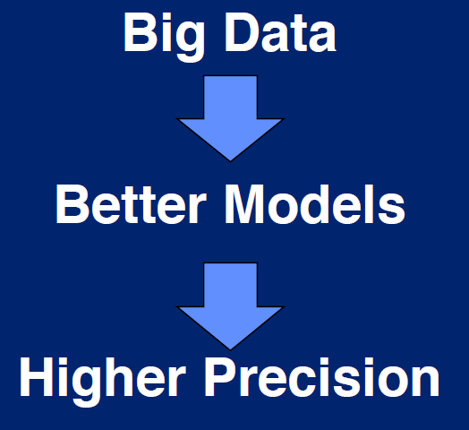
What Makes Big Data Valuable??

Slide 31

What Makes Big Data Valuable??

Slide 32

Personalized Marketing

Slide 33
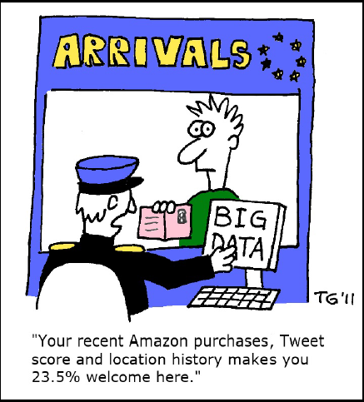
Personalized Marketing

Slide 34

Recommendation Engines

Slide 35

Sentiment Analysis

Slide 36

Mobile Advertising

Slide 37

Mobile Advertising

Slide 38

Geolocation Data

Slide 39

Consumer growth to Guide Product growth

Slide 40

Consumer growth to Guide Product growth

Slide 41
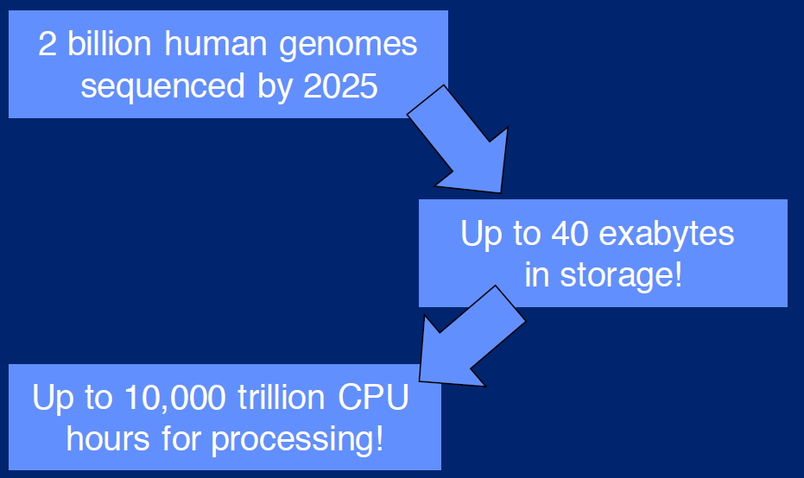
Bio Medical Applications

Slide 42

Personalized Cancer Treatment

Slide 43

Personalized Cancer Treatment

Slide 44

Smart Cities

Slide 45
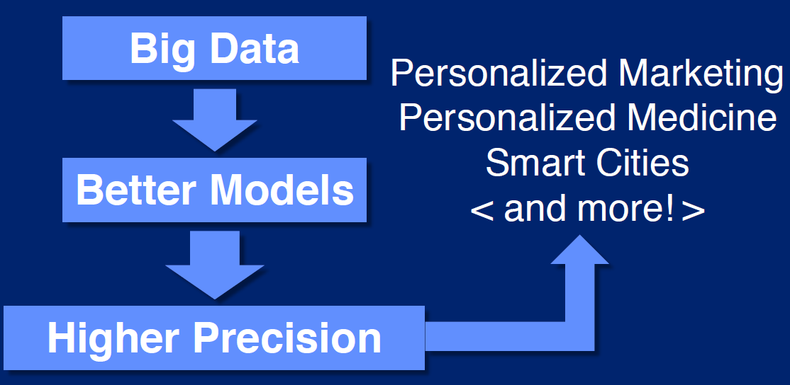
Smart and Personalized Business

